Slide 1
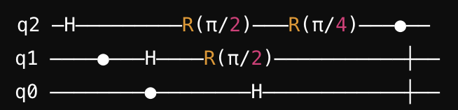
Shor’s Algorithm Breaking Public Key Cryptography
Understanding the math involved such that we can break more stuff
Notes:
Goals math is very accessible
Dont need to know depth of physics
Some of the people will break the next gen algorithms
With some clever math and tranformation

Slide 2
Shor’s Algorithm for Breaking Public Key Cryptography: Computing by hand and Quantum Computers
Public Key Cryptography
RSA and Factorization
Factorization complexity
Shor’s Algorithm by hand
Key insights: factorization ➔ order/period finding
The Algorithm
The Manual Example
Bonus: The Simple Tool
Advanced Proofs: Euclid's GCD, Euler’s Totient
Shor’s Algorithm Quantum
The Speed up
The Extraction QFT
The Extraction: Continued fractions

Slide 3
Public Key Cryptography: RSA and Factorization
Basic RSA
Breaks with Factorization
Generate Keys
Choose tow primes p=61, q=53.
Compute n=61×53=3233
Euler’s Totient (number of coprimes < n)
ϕ(n)=(61−1)×(53−1)=3120.
Choose e=17, as it’s coprime with 3120.
Compute d such that (17×d) mod 3120=1, d=2753
The public key is (3233,17), and the private key is (3233,2753).
Encrypt/Decrypt
To encrypt m=65:
c= 65¹⁷ mod 3233 = 2790
To decrypt c=2790:
m = 2790²⁷⁵³ mod 3233 = 65
Find Factors
If we can factorize n 3233.
Then we determine p=61 and q=53
Generate Private Key
Then we can compute ϕ(n)=(61−1)×(53−1)=3120
Then using e=17 from public key (3233,17)
We can compute (17×d) mod 3120=1, d=2753
Determine the private key is (3233,2753)
Notes:
17*d - 1 = 3120*n

Slide 4
Public key Cryptography: Factorization is hard
Hard = non polynomial time or exponential time
Best algorithm’s we can do is slightly worse than O(e^{∛b})
Notice it is a “b” as in bits or binary digits
Factorize 51983
Try to divide by all primes up to square root
--- --- 002 003 --- 005 --- 007 --- --- --- 011 --- 013 --- --- --- 017 --- 019 --- --- --- 023 --- --- --- --- --- 029 --- 031 --- --- --- --- --- 037 --- --- --- 041 --- 043 --- --- --- 047 --- --- --- --- --- 053 --- --- --- --- --- 059 --- 061 --- --- --- --- --- 067 --- --- --- 071 --- 073 --- --- --- --- --- 079 --- --- --- 083 --- --- --- --- --- 089 --- --- --- --- --- --- --- 097 --- --- --- 101 --- 103 --- --- --- 107 --- 109 --- --- --- 113 --- --- --- --- --- --- --- --- --- --- --- --- --- 127 --- --- --- 131 --- --- --- --- --- 137 --- 139 --- --- --- --- --- --- --- --- --- 149 --- 151 --- --- --- --- --- 157 --- --- --- --- --- 163 --- --- --- 167 --- --- --- --- --- 173 --- --- --- --- --- 179 --- 181 --- --- --- --- --- --- --- --- --- 191 --- 193 --- --- --- 197 --- 199 --- --- --- --- --- --- --- --- --- --- --- 211 --- --- --- --- --- --- --- --- --- --- --- 223 --- --- --- 227 --- --- 229

Slide 5
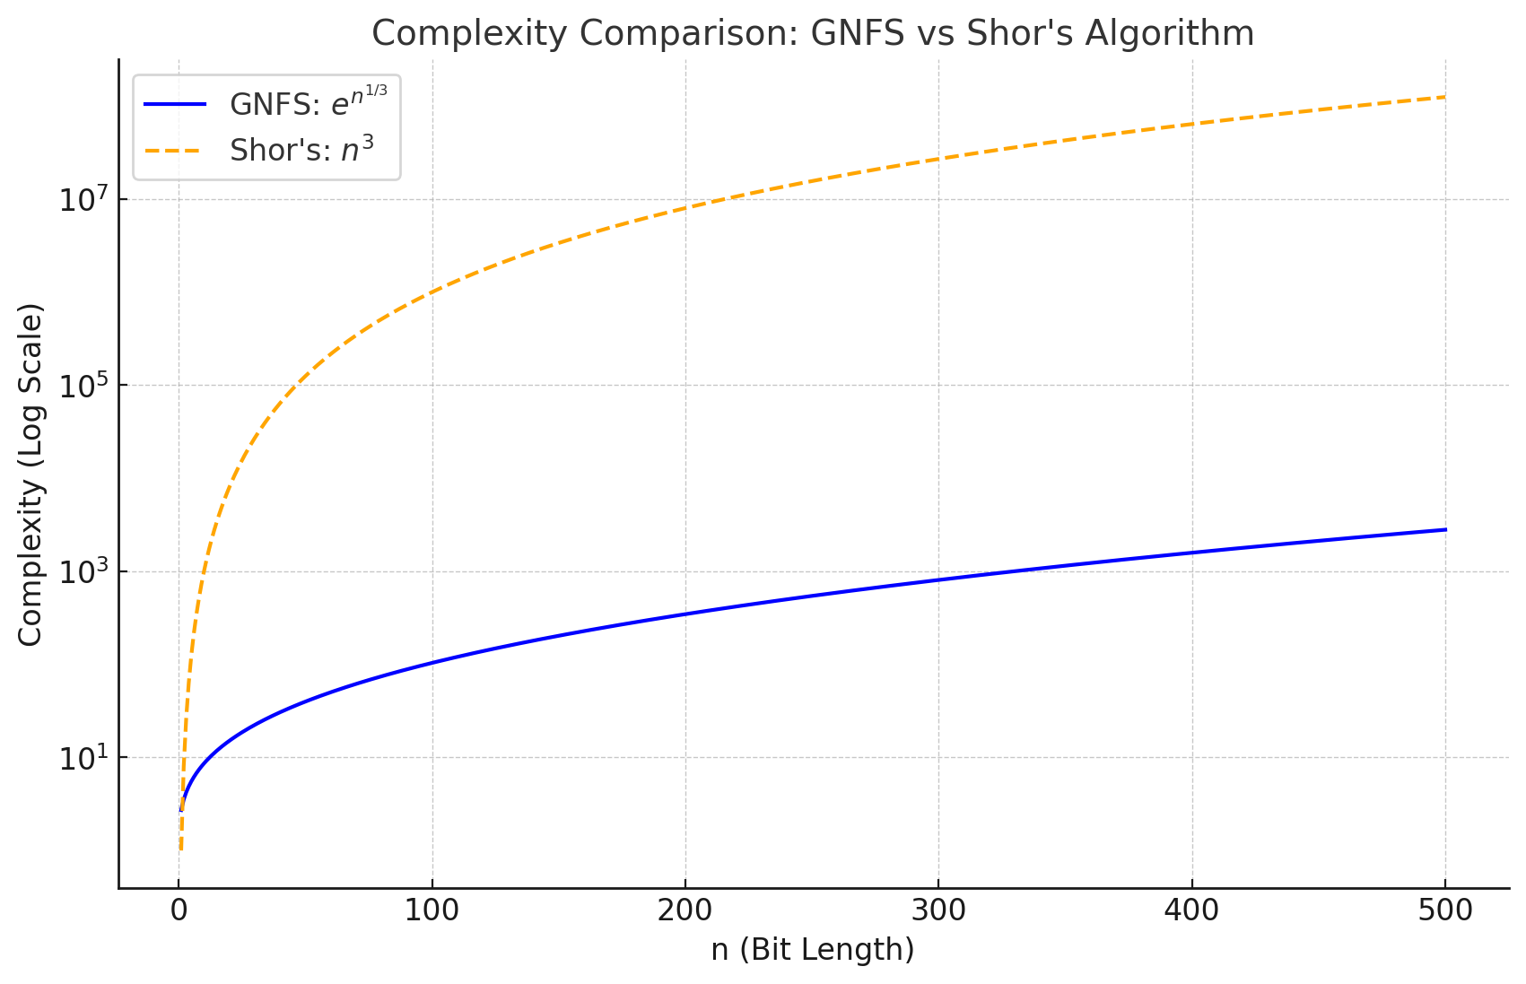
Shor’s Algorithm can make factorization easy
Makes factorization easy = polynomial time complexity
O(b³) is much much better than O(e^{∛b})
Requires quantum computing to speed up otherwise it is much worse O(2^{b})

Slide 6
Shor’s algorithm by hand: Key Insights
Euclid’s GCD
If we can find another number with common factors with N then we can find the common factor using GCD
Finding GCD is easier (less complex) than factorization due to Euclid's algorithm
GCD (N, M) will give factors faster
a² – b² = (a-b)(a+b)
(x + 1) * (x – 1) = m* N
x ² – 1 = m*N
x ² mod N = 1
GCD (N, x – 1) and GCD (N, x +1) will give us factors of N
Period/order finding
Random guess ‘G’ <= √N, the probability it is a factor = 1/√N
If G and N are coprime for some power p of G
G*G…G, G^{p} mod N = 1
G^{p/2} -1 mod N = 1
(G^{p/2} + 1) * (G^{p/2} – 1) = m*N
GCD(G^{p/2} +1, N) are factors of N
Probability is 1 – 2/num of factors >= 1/3

Slide 7
Shor’s algorithm by hand: Algorithm

Slide 8
Shor’s algorithm by hand: Simple Example, Manual Computation
Factors P = 7, Q = 5 | Remainder R = G^{x} mod N | Period P =12
Number N = P*Q = 35 |  | G^{p/2} ± 1 = 2^{12/2} ± 1 = 63, 65
Guess G = 2 |  | Factor1 = GCD (63, 35) = 7
 |  | Factor2 = GCD (65, 35) = 5
G^{x} | G^{x} mod N | R
2¹ | 2 mod 35 | 2
2² | 4 mod 35 | 4
2³ | 8 mod 35 | 8
2⁴ | 16 mod 35 | 16
2⁵ | 32 mod 35 | 32
2⁶ | 64 mod 35 | 29
2⁷ | 128 mod 35 | 23
2⁸ | 256 mod 35 | 11
2⁹ | 512 mod 35 | 22
2¹⁰ | 1024 mod 35 | 9
2¹¹ | 2048 mod 35 | 18
2¹² | 4096 mod 35 | 1

Slide 9
Shor’s algorithm by hand: Computation Tool
https://github.com/satyamtyagi/Shor-Excel
Guess G | Number N = P * Q | Remainde R = G^x mod(N) | Powers x | Powers of Guess G^x | Period P = power x if remainder R = 1 | G^P/2 | GCD (G^P/2 -1, N) | GCD (G^P/2 -1, N)
2 | 35 | 2 | 1 | 2 | 12 | 64 | 7 | 5
 | 5 | 4 | 2 | 4
 | 7 | 8 | 3 | 8
 |  | 16 | 4 | 16
 |  | 32 | 5 | 32
 |  | 29 | 6 | 64
 |  | 23 | 7 | 128
 |  | 11 | 8 | 256
 |  | 22 | 9 | 512
 |  | 9 | 10 | 1024
 |  | 18 | 11 | 2048
 |  | 1 | 12 | 4096

Slide 10
Shor’s algorithm by hand: Euclid's GCD
Euclid’s GCD Algorithm
A>B
GCD (A, B) = GCD (A, Remainder R = A mod B)
Simple Proof
Remainder R = A – B*n where B*n <= A and B*(n+1) > A
g = GCD (A, B), then A = g*a, B=g*b
R = A – B*n
R = g*b – g*(a*n)
R = g*(b – a*n)
GCD (R, B) = g

Slide 11
Shor’s algorithm by hand: Euler’s Totient
What we want to prove is for some power of G*G…G
G^{p} mod N = 1
What we know is G < N and are coprime
Otherwise GCD(G, N) will give us a factor
G mod N = G
G*G…G will all be coprime to N and mod N will give us new remainders Rs all < N and hence are finite set and at some power of G will start repeating
At some x > 1 G^{x} mod N = G
G^{x} – N*m = G
N*m = G^{x} – G
N*m = G * (G^{x-1} – 1)
Since G and N are coprime that means (G^{x-1} – 1) is a multiple of N
G^{x-1} – 1 = kN
Taking mod N on both sides
(G^{x-1} – 1) mod N = 0 or G^{x-1} mod N = 1 (In other words if number is divisible by N, number + 1 will give reminder of 1 when divided by N)

Slide 12
Shor’s Algorithm: Quantum speed up
G^{x} | G^{x} mod N | R
2¹ | 2 mod 35 | 2
2² | 4 mod 35 | 4
2³ | 8 mod 35 | 8
2⁴ | 16 mod 35 | 16
2⁵ | 32 mod 35 | 32
2⁶ | 64 mod 35 | 29
2⁷ | 128 mod 35 | 23
2⁸ | 256 mod 35 | 11
2⁹ | 512 mod 35 | 22
2¹⁰ | 1024 mod 35 | 9
2¹¹ | 2048 mod 35 | 18
2¹² | 4096 mod 35 | 1

Slide 13
Shor’s Algorithm: Quantum extraction with QFT
Fourier Transform: Breaks down composite waveform into its component wave frequencies
QFT: Kind of does the same it exploits the periodicity in our p
As not only G^{p} mod N = 1
But also G^{x+p} mod N = G^{x}
Applying QFT
Input State Preparation
Apply QFT
Measure Quantum Register
But this gives a relationship to our period p
k/2^{n} = j/p
Where k is the measured output, n is the number of qbits, j is some integer and p is the period (what we are really after )

Slide 14
Shor’s Algorithm: Extracting Period from QFT with Continued Fractions
QFT gives us frequency, period p is inverse of frequency with a bit of math,
Reduce k/2^{n} to Its Simplest Form:
Use continued fraction expansion to approximate k/2^{n} as a fraction j/p with the smallest denominator p.
Validate the Candidate Period p:
For each candidate p obtained from the continued fraction, check if p satisfies the modular equation
G^{p} mod N = 1

Slide 15
Shor’s Algorithm: QFT Continued Fractions example
N=15, G=7,
k = 6, n = 3 qbits, (N=15)
Compute k/2^{n} = j/P:
k/2^{n} = 6/8 = ¾ = 0.75
j/P = a + 1/(a’ + 1/(a” + …)
a = 0 (integer part of 0.75)
a’ = 1 (integer part of 1/0.75 or 1.33)
a” = 3 (integer part of 1/.33 or 3)
j/P = a + 1/(a’ + 1/(a” + …)
j/P = 1/ (1 + 1/3) = 1/(4/3)
j/P = 3/4
Validate P satisfies G^{p} mod N = 1:
7⁴ mod 15 = 2401 mod 15 = 1
satisfied

